Slide 1



Date
May 2, 2025
Product Development, Marketing Strategies, &
Customer Engagement
by
Batch
Assignment
Linkedin
Link
Ahmad Rizki
RevoU FSDA batch FEB25
Advance
Data Visualization
www.linkedin.com/in/arizabdulhanan
Power BI Link

Slide 2

Business Requirement & Objective
1
Why
3
The reason is to help management finding strategic decisions including on product development, marketing strategies, and customer engagement to enhance the company’s market share and profitability.
Who
2
What
The dashboard is made based on email request from the management to have strategic decisions.
By addressing some metrics that are suitable the company’s needs, such as :
- Total Sales Amount
- Total Discount Amount
- Avg. of Products per Customers
- Avg. of Reviews per Customers
- Game Rating Percentage
- The Most Played Game

Slide 3
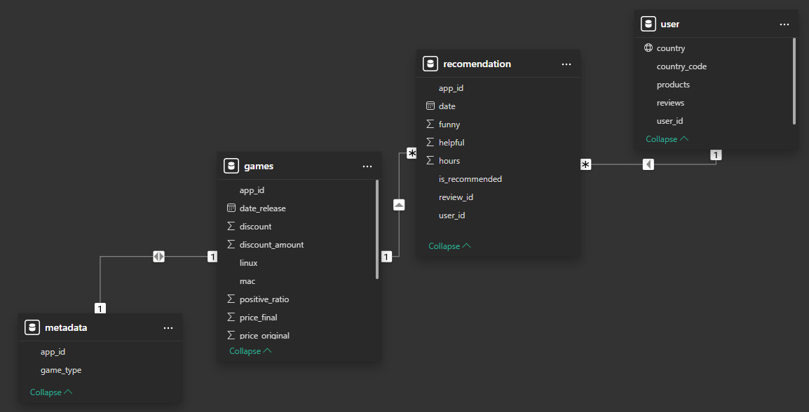
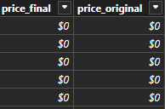
Data Preparation
Connect and Combine / Join
Add a connection to Steam Game dataset. The files that we used in Excel file format.
Ensure that each table is connected in the ‘model view’.
Ensure every single column is in correct data type in the ‘table view’. In this case, we convert price_final and price_original into USD. And also change data category of country column into ‘country’.
If there is something that needs to be changed or fixed about the data type and others, then it needs to be changed first in the ‘transform data’ menu.

Slide 4
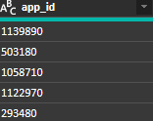
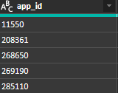
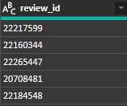
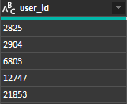
Data Preparation
Check Data Type
Games Table
- Convert App ID into string
- Make a new column of ‘discount_amount’
Metadata Table
- Convert App ID into string
Recommendation Table
- Convert Review ID into string
- Convert App ID into string
- Convert User ID into string
User Table
- Convert User ID into string

Slide 5
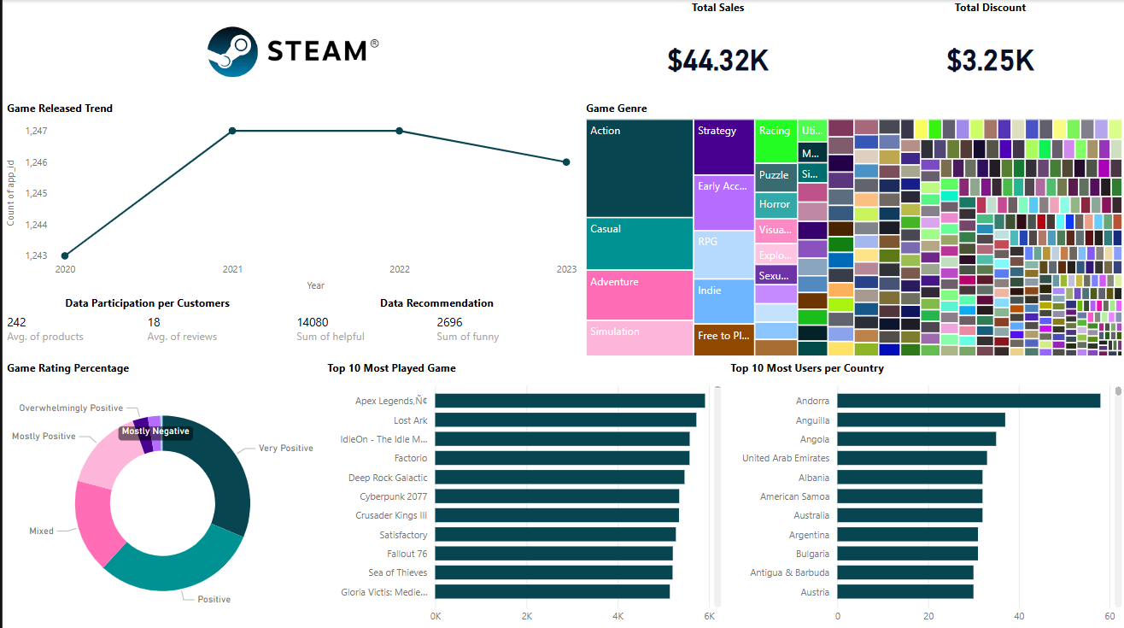

Slide 6
Insights
Our company has total Total Sales 44,32K with Total Discount 3,25K from Jan 1, 2020 to Dec Jun 13, 2023.
Of all the games released, there are 4,909 games that are compatible using Windows, 939 games that are compatible using Mac, and 660 games that are compatible using Linux.
Most of the games released are in the action genre with a total of 415 games, followed by the casual genre with a total of 222 games, then adventure genre with a total of 212, and so on.
From the existing data, on average each customer buys up to 242 games. And on average each customer gives a review up to 18 times.
From the existing data, it shows that 14,080 users felt helped by the existing recommendations.
From the reviews given by customers, there are 31.31% with a very positive rating, 30.54% with a positive rating, 17.26% with a mixed rating, and so on.
The game with the highest number of hours played is Apex Legends with 5,914 hours, followed by Lost Ark with 5,725 hours, IdleOn with 5,578 hours, and so on.
The country with the largest number of users is Andorra with 58 users, followed by Anguilla with 37 users, Angola with 35 users, and so on.

Slide 7
Recommendations
Use player behavior like what they play most, how long they play, and even what they review to make smarter, more personalized suggestions. It'll make their experience better and likely increase how much they buy and play.
Focus development and support on Windows gaming, because most of users gaming on Windows.
Make it easier for users to discover new titles in the categories they already like, and consider spotlighting top performing games.
Over 60% of reviews are positive or very positive, so highlight the positive feedback to build trust with new players and reassure hesitant buyers.
Look into expanding into larger markets with tailored marketing and support, things like local language, payment methods, and promotions can go a long way, because the user base is small and spread thin across countries like Andorra and Anguilla.
Offer smarter and more targeted discounts that increase revenue without giving too much.

Slide 8
Thank You
For Your Attention …
by
Batch
Assignment
Linkedin
Link
Ahmad Rizki
RevoU FSDA batch FEB25
Advance
Data Visualization
www.linkedin.com/in/arizabdulhanan
Power BI Link

